Slide 1
Support Vector Machine(SVM)

Slide 2
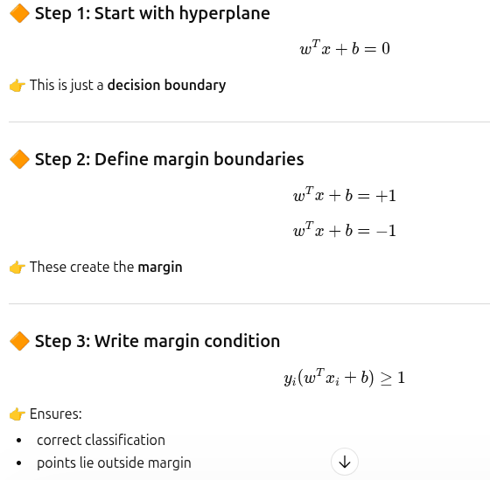
SVM

Slide 3
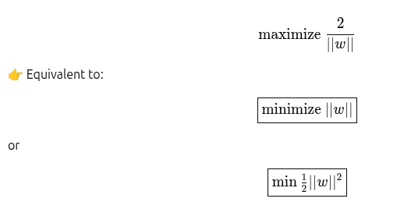
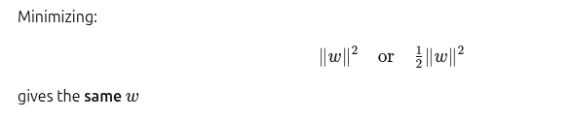
Step 4- solve using lagrange

Slide 4
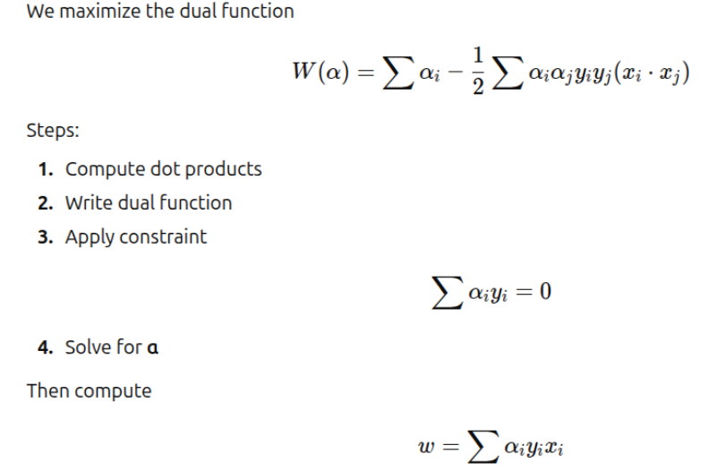
SVM- Lagrange method

Slide 5
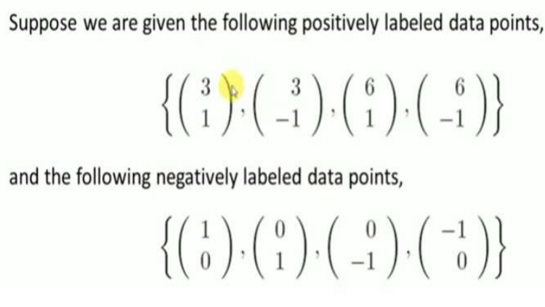
Example

Slide 6
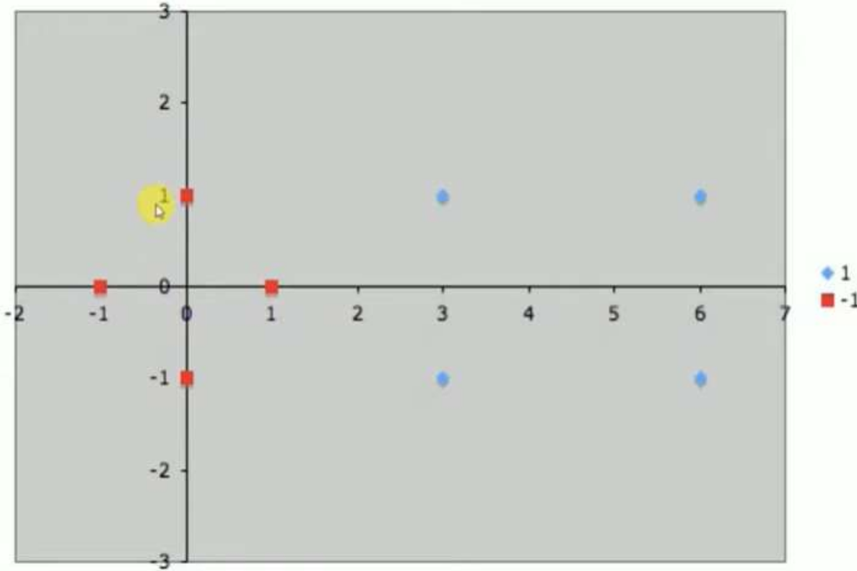

Slide 7
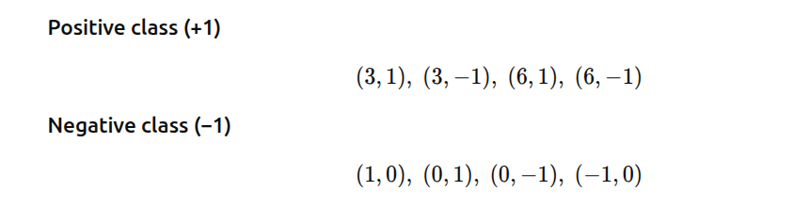

Slide 8
Distance calculation
Calculate distance between every positive point and every negative point

Slide 9
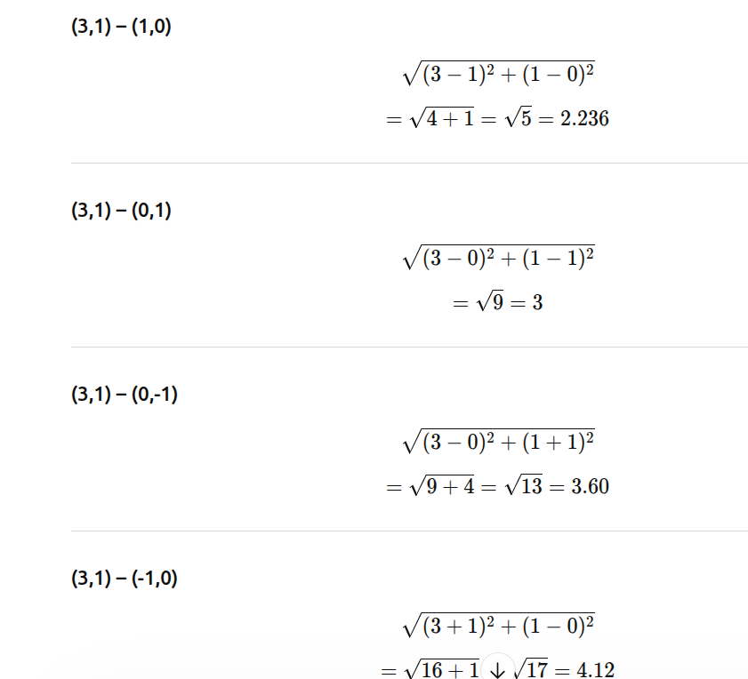

Slide 10
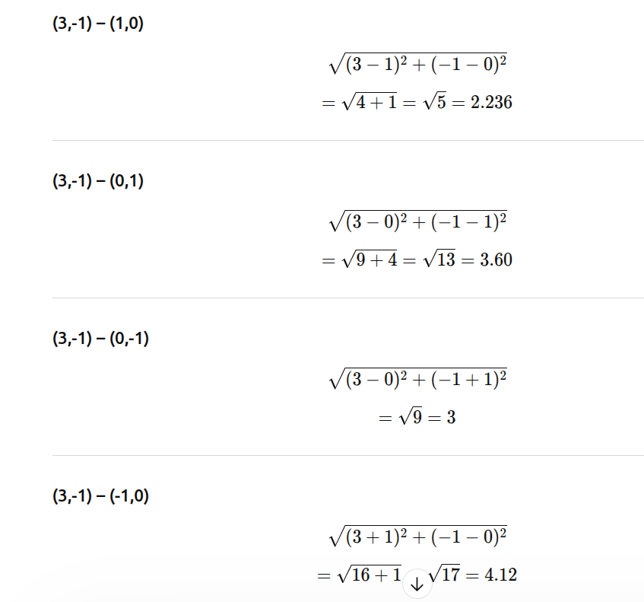

Slide 11
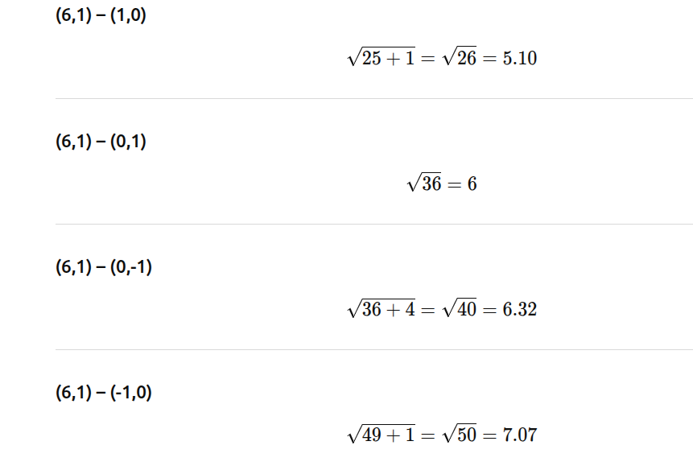

Slide 12
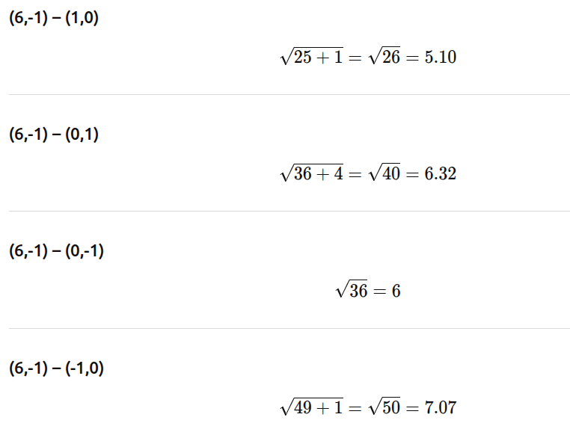

Slide 13
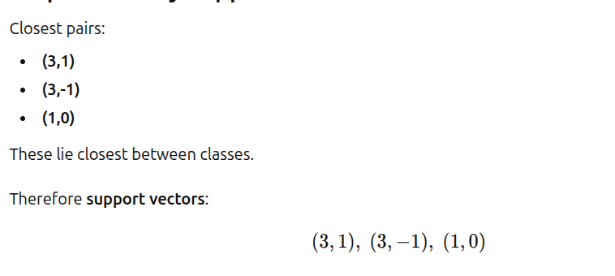
Smallest distance=2.236

Slide 14
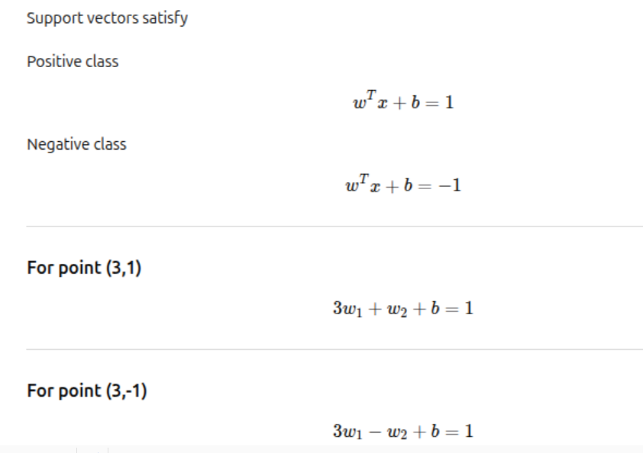
Use margin conditions (lagrange also be used)

Slide 15

For point (1,0), w1 + b = -1
Subtract first and second equation,

Slide 16
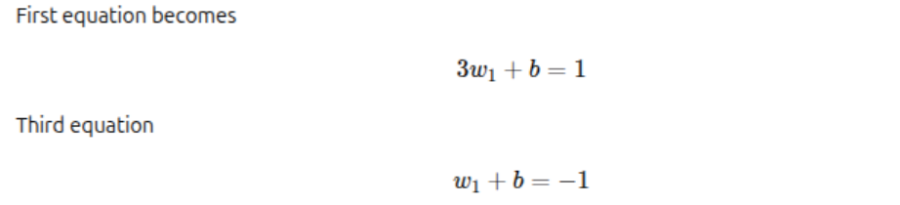
To compute w1
Substitute w2=0,

Slide 17
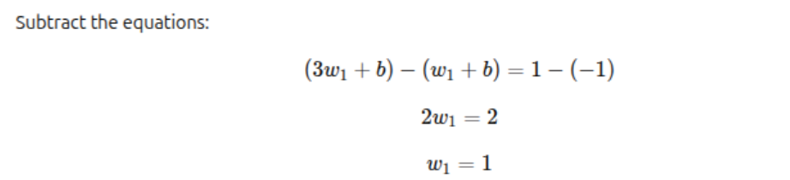

Slide 18

Compute Bias
Use any eqn above,

Slide 19
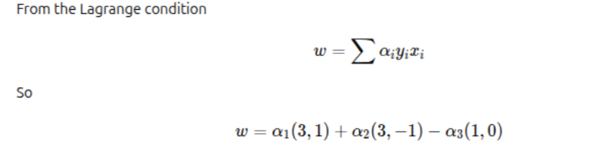
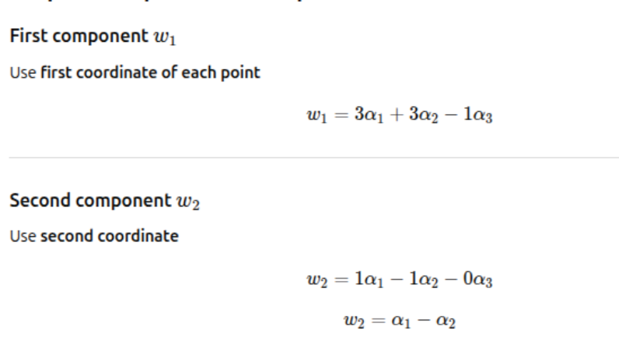

Slide 20
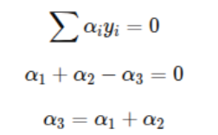
Constraint from lagrange

Slide 21
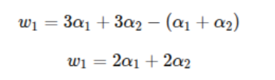
Substitute in w1

Slide 22



To solve α, substitute w1=1,w2=0

Slide 23
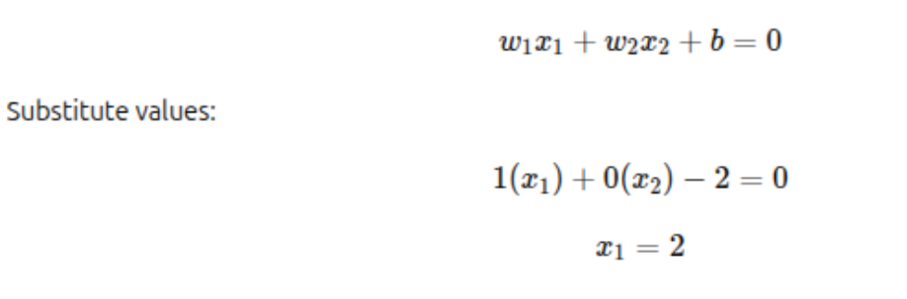

Final weight vector w=(1,0) and b= -2
Final Hyperplane

Slide 24
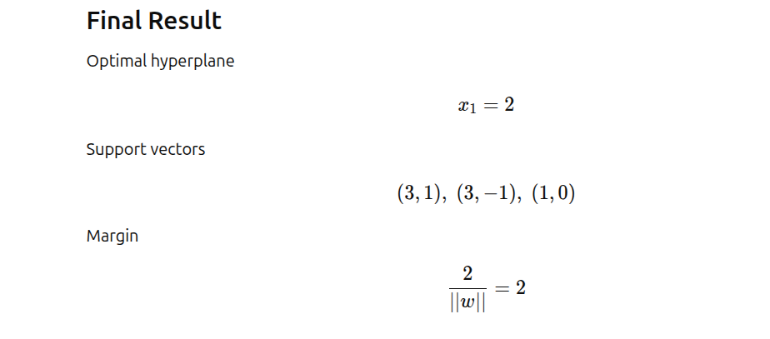
Weight, w=(1,0) and bias, b= -2

Slide 25
